Slide 1
JOIN Clause
- Morshedul Arefin

Slide 2
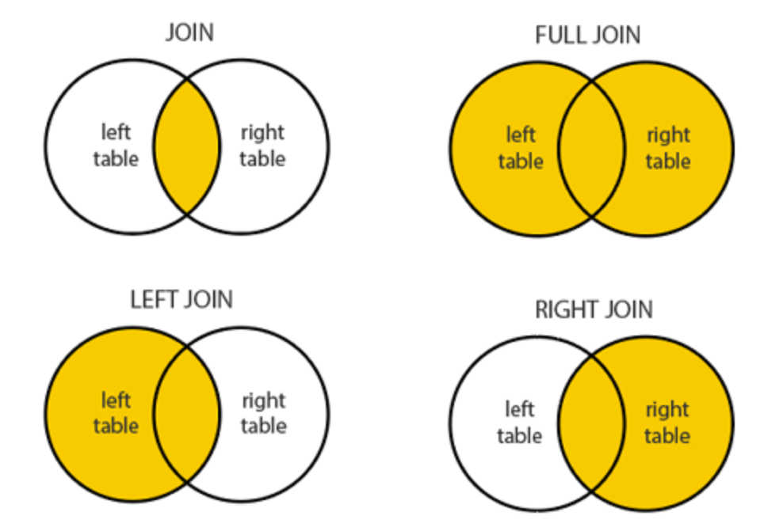
Join Clause
A JOIN clause is used to combine rows from two or more tables, based on a related column between them.

Slide 3
Types
Inner Join: Returns records that have matching values in both tables
Left (outer) Join: Returns all records from the left table, and the matched records from the right table
Right (outer) Join: Returns all records from the right table, and the matched records from the left table
Full (outer) Join: Returns all records when there is a match in either left or right table

Slide 4
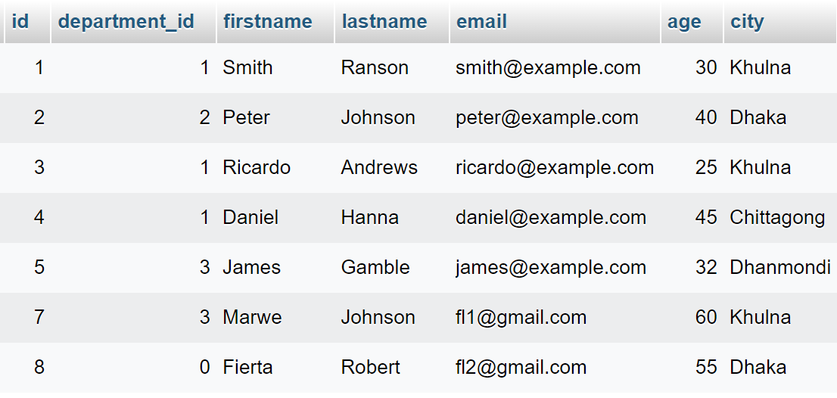
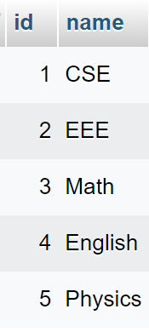
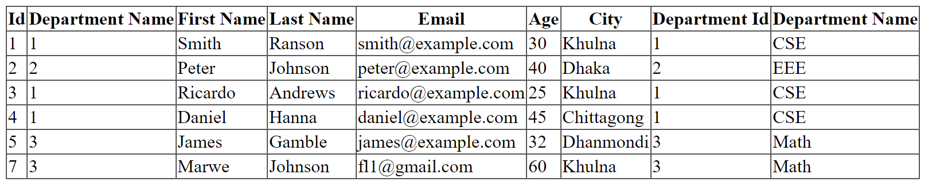
Example – Inner Join
Table: students
Table: departments

Slide 5
Example – Inner Join – Code
$statement = $conn->prepare("SELECT
s.id as sid,
s.department_id,
s.firstname,
s.lastname,
s.email,
s.age,
s.city,
d.id as did,
d.name as dname
FROM students s
INNER JOIN departments d
ON s.department_id = d.id");
$statement->execute();
$result = $statement->fetchAll(PDO::FETCH_ASSOC);

Slide 6
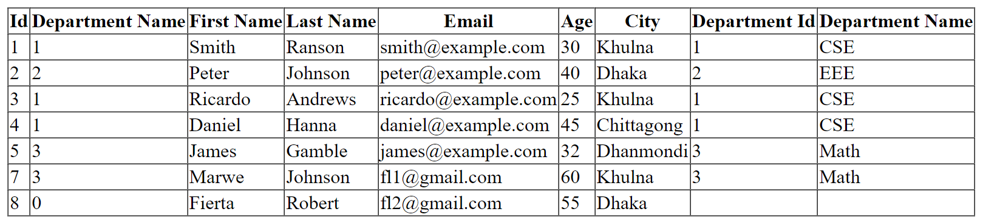
Example – Left Join
Table: students
Table: departments

Slide 7
Example – Left Join – Code
$statement = $conn->prepare("SELECT
s.id as sid,
s.department_id,
s.firstname,
s.lastname,
s.email,
s.age,
s.city,
d.id as did,
d.name as dname
FROM students s
LEFT JOIN departments d
ON s.department_id = d.id");
$statement->execute();
$result = $statement->fetchAll(PDO::FETCH_ASSOC);

Slide 8
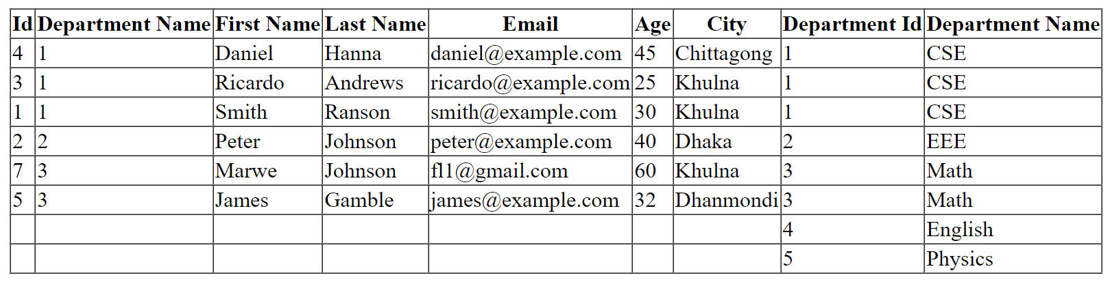
Example – Right Join
Table: students
Table: departments

Slide 9
Example – Right Join – Code
$statement = $conn->prepare("SELECT
s.id as sid,
s.department_id,
s.firstname,
s.lastname,
s.email,
s.age,
s.city,
d.id as did,
d.name as dname
FROM students s
RIGHT JOIN departments d
ON s.department_id = d.id");
$statement->execute();
$result = $statement->fetchAll(PDO::FETCH_ASSOC);

Slide 10
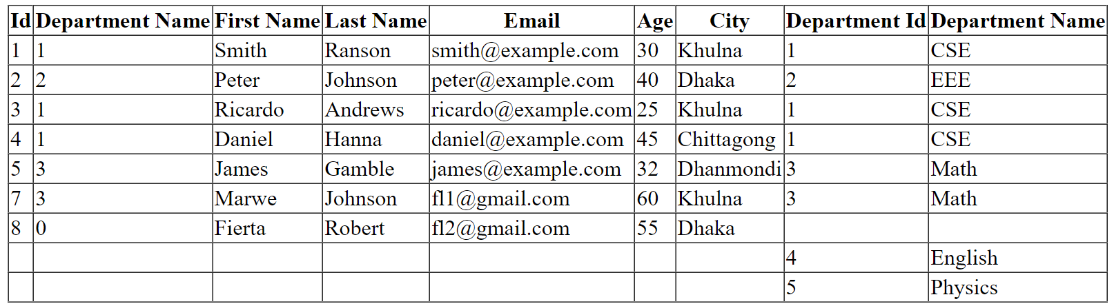
Example – Full Join
Table: students
Table: departments

Slide 11
Example – Full Join – Code
$statement = $conn->prepare("SELECT
s.id as sid, s.department_id, s.firstname, s.lastname, s.email,
s.age, s.city, d.id as did, d.name as dname
FROM students s
LEFT JOIN departments d
ON s.department_id = d.id
UNION
SELECT
s.id as sid, s.department_id, s.firstname, s.lastname, s.email,
s.age, s.city, d.id as did, d.name as dname
FROM students s
RIGHT JOIN departments d
ON s.department_id = d.id");
$statement->execute();
$result = $statement->fetchAll(PDO::FETCH_ASSOC);

